Slide 1
Dynamic and Online Algorithms for Set Cover
Anupam Gupta
Carnegie Mellon University
Ravishankar Krishnaswamy (Microsoft India)
Amit Kumar (IIT Delhi) and
Debmalya Panigrahi (Duke)

Slide 2
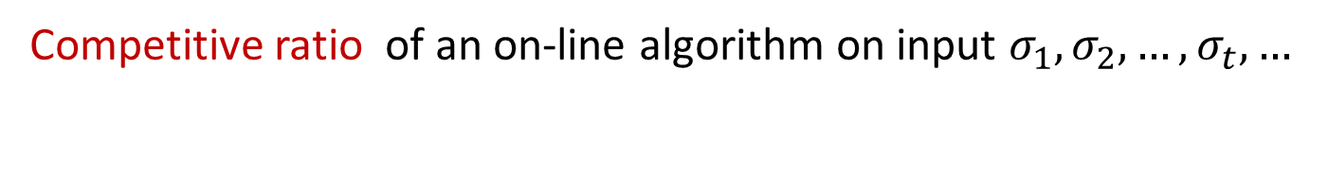
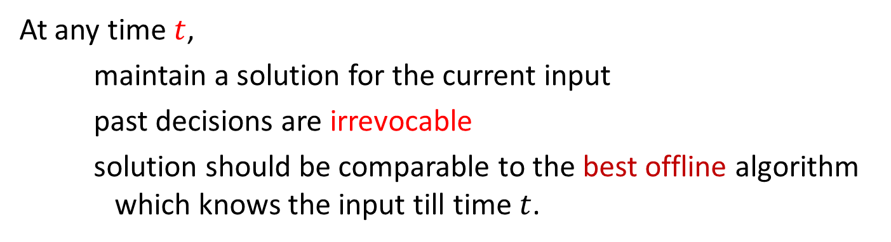
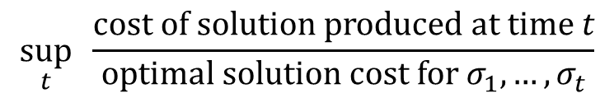
online algorithms and competitive analysis
At any time $t$,
    maintain a solution for the current input
    past decisions are irrevocable
    solution should be comparable to the best offline algorithm
    which knows the input till time $t$.
Competitive ratio of an on-line algorithm on input $σ_{1}, σ_{2}, …, σ_{t}, …$
$$\sup_{t} \frac{\text{cost} \text{of} \text{solution} \text{produced} \text{at} \text{time} t}{\text{optimal} \text{solution} \text{cost} \text{for} σ_{1},…, σ_{t}}$$

Slide 3

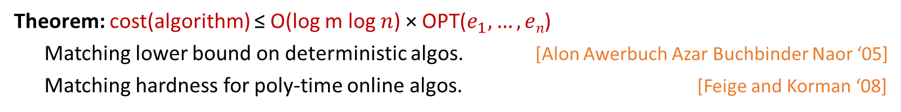

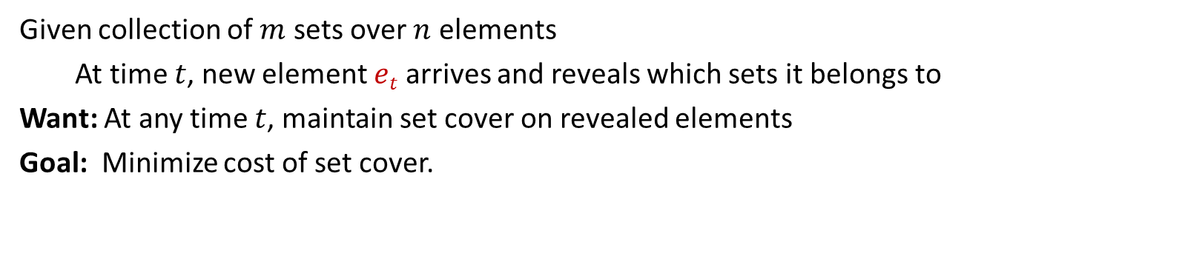



online set cover
$$e_{5}$$
$$e_{4}$$
$$e_{3}$$
$$e_{2}$$
$e_{1}$
Given collection of $m$ sets over $n$ elements
  At time $t$, new element $et$ arrives and reveals which sets it belongs to
Want: At any time $t$, maintain set cover on revealed elements
Goal: Minimize cost of set cover.
Theorem: cost(algorithm) ≤ O(log m log $n$) × OPT($e_{1}, …, en$)
Matching lower bound on deterministic algos. [Alon Awerbuch Azar Buchbinder Naor ‘05]
Matching hardness for poly-time online algos. [Feige and Korman ‘08]

Slide 4
(dynamic) online algorithms
At any time $t$,
    maintain a solution for the current input
    past decisions are irrevocable
    solution should be comparable to the best offline algorithm
    which knows the input till time $t$.
Relax this requirement. Still compare to clairvoyant OPT.
Measure number of changes (“recourse”) per arrival
- e.g., at most O(1) changes per arrival (worst-case)
- or, at most t changes over first t arrivals (amortized)
Competitive ratio of an on-line algorithm on input $σ_{1}, σ_{2}, …, σ_{t}, …$
$$\sup_{t} \frac{\text{cost} \text{of} \text{solution} \text{produced} \text{at} \text{time} t}{\text{optimal} \text{solution} \text{cost} \text{for} σ_{1},…, σ_{t}}$$
a.k.a. dynamic (graph) algorithms:
traditionally measure the update time instead of #changes, we measure recourse.
traditionally focused on (exact) graph algorithms, now for appox.algos too.

Slide 5
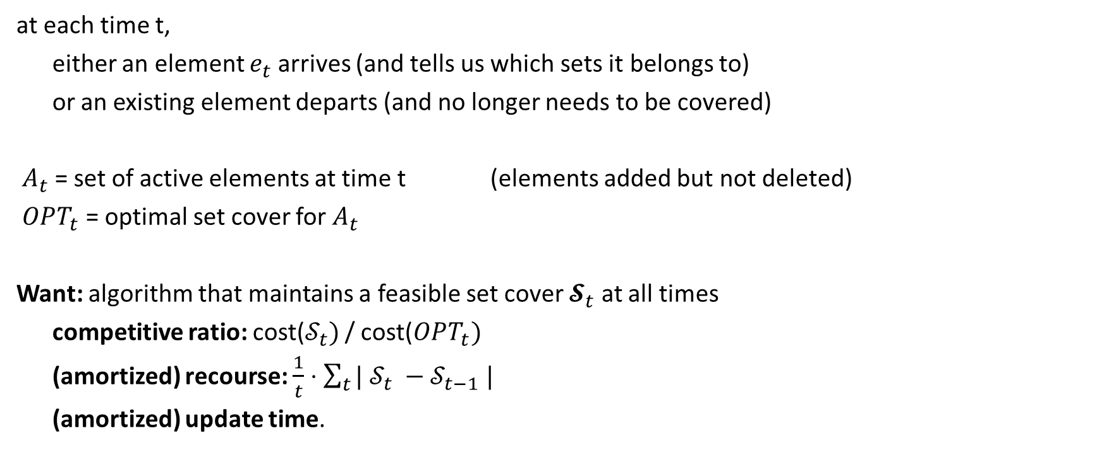
the model, formally
at each time t,
either an element $e_{t}$ arrives (and tells us which sets it belongs to)
or an existing element departs (and no longer needs to be covered)
$A_{t}$ = set of active elements at time t (elements added but not deleted)
$OPT_{t}$ = optimal set cover for $A_{t}$
Want: algorithm that maintains a feasible set cover $𝓢_{t}$ at all times
competitive ratio: cost($𝒮_{t})$ / cost($OPT_{t})$
(amortized) recourse: $\frac{1}{t}⋅\sum_{t}{| 𝒮_{t} −𝒮_{t−1} |}$
(amortized) update time.

Slide 6






our results (recourse)
Classical Online model: competitive ratio $O(\log{m}log⁡n)$, tight in most respects
$$e_{5}$$
$$e_{4}$$
$$e_{3}$$
$$e_{2}$$
$e_{1}$
Dynamic set cover:
Theorem 1. Algorithm that is $O(\log{n)}$ competitive, with $O\left(1\right)$ recourse (amortized).
Theorem 2. Algorithm that is $O(f)$ competitive (randomized), with $O\left(1\right)$ recourse (amortized).
$f$is the frequency = maximum number of sets containing an element
e.g. vertex cover has $f=2.$
The results extend to showing $O(\log{n_{t})}$ and $O(f_{t})$ competitiveness.

Slide 7
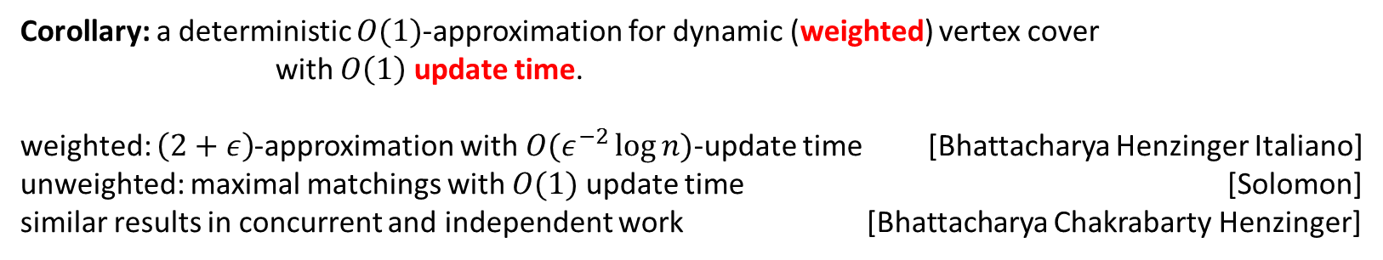
our results (update time)
Classical Online model: competitive ratio $O(\log{m}log⁡n)$, tight in most respects
$$e_{5}$$
$$e_{4}$$
$$e_{3}$$
$$e_{2}$$
$e_{1}$
Dynamic set cover:
Theorem 1b. Algorithm that is $O(\log{n)}$ competitive, with $O\left(f\log{n}\right)$ update time (amortized).
Theorem 2b. Algorithm that is $O(f^{3})$ competitive (randomized), with $O\left(f^{2}\right)$ update time (amortized).
Corollary: a deterministic $O(1)$-approximation for dynamic (weighted) vertex cover
with $O\left(1\right)$ update time.
weighted: $\left(2+ε\right)$-approximation with $O(ε^{−2}\log{n)}$-update time [Bhattacharya Henzinger Italiano]
unweighted: maximal matchings with $O(1)$ update time [Solomon]
similar results in concurrent and independent work [Bhattacharya Chakrabarty Henzinger]
Prior
work

Slide 8
our results (recourse)
Classical Online model: competitive ratio $O(\log{m}log⁡n)$, tight in most respects
$$e_{5}$$
$$e_{4}$$
$$e_{3}$$
$$e_{2}$$
$e_{1}$
Dynamic set cover:
Theorem 1. Algorithm that is $O(\log{n)}$ competitive, with $O\left(1\right)$ recourse (amortized).
Today:
Measure recourse.
Assume unit cost sets.
Get O(log n) competitive with O(log n) recourse.

Slide 9
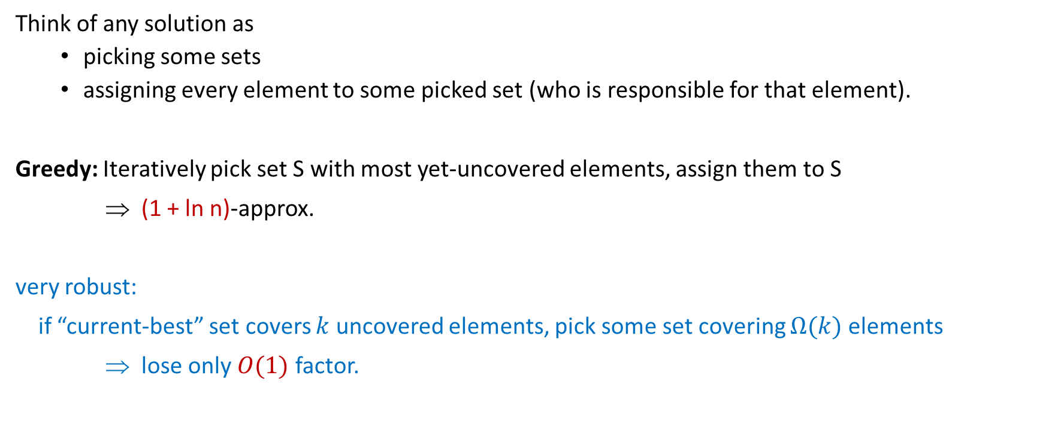
offline: the greedy algorithm
Think of any solution as
  picking some sets
  assigning every element to some picked set (who is responsible for that element).
Greedy: Iteratively pick set S with most yet-uncovered elements, assign them to S
⇒ (1 + ln n)-approx.
very robust:
if “current-best” set covers $k$ uncovered elements, pick some set covering $Ω(k)$ elements
⇒ lose only $O(1)$ factor.

Slide 10
the online algorithm
density = 3
density = 2
density = 2
density = 1
Universe of current points

Slide 11








the online algorithm
density = 3
density = 2
density = 2
density = 1
$$e_{1}$$
$$e_{2}$$
$$e_{5}$$
$$e_{3}$$
$$e_{8}$$
$$e_{4}$$
$$e_{7}$$
$$e_{6}$$

Slide 12








the online algorithm
$$e_{6}$$
density = 1
$$e_{3}$$
$$e_{8}$$
$$e_{4}$$
$$e_{7}$$
density = 2
$$e_{1}$$
$$e_{2}$$
$$e_{5}$$
density [3,4]
density [5,8]

Slide 13
the online algorithm
$$e_{6}$$
density = 1
$$e_{3}$$
$$e_{8}$$
$$e_{4}$$
$$e_{7}$$
density = 2
$$e_{1}$$
$$e_{2}$$
$$e_{5}$$
density [3,4]
density [5,8]
Unstable set S: set that contains ${∈(2^{i−1},2}^{i}]$ elements, all currently being covered at densities $≤2^{i−1}$.
E.g., suppose some set contains $e_{3}, e_{6}$ and $e_{8}$. Then it is unstable.
Lemma: no unstable sets $⇒$ solution is almost greedy $⇒$ solution is O(log n)-approximate.

Slide 14





the online algorithm
$$e_{3}$$
$$e_{6}$$
$$e_{9}$$
$$e_{9}$$
$$e_{6}$$
density = 1
$$e_{3}$$
$$e_{8}$$
$$e_{4}$$
$$e_{7}$$
density = 2
$$e_{1}$$
$$e_{2}$$
$$e_{5}$$
density [3,4]
density [5,8]
Suppose $e_{9}$ arrives. Cover it with any set containing it.
Now green set is unstable.
So add it in, and assign $e_{3},e_{6},e_{9}$ to it.
Clean up, resettle sets at the right level.

Slide 15

overview of the analysis
Invariant: element at level $≈2^{i}$ has $2(log⁡n – i)$ tokens
When a new element arrives and not covered by current sets,
pick any set that covers it, add it with density 1
If some unstable set exists, add it to the correct level, assign those elements to it.
May cause other sets to lose elements, become lighter.
They “float up” to the correct level.
Cause other sets to become unstable, etc.
Claim: system stabilizes. Also, O(log n) changes per arrival, amortized.
Start each element with $2\log{n}$ tokens
Elements moving down lose 2 tokens
use 1 to pay for new set
Sets moving up lose ½ of their elements
use their other token to pay for rising up*
*minor cheating here.

Slide 16
a quick word about update time algorithms
Classical Online model: competitive ratio $O(\log{m}log⁡n)$, tight in most respects
$$e_{5}$$
$$e_{4}$$
$$e_{3}$$
$$e_{2}$$
$e_{1}$
Dynamic set cover:
Theorem 2b. Algorithm that is $O(f^{3})$ competitive (randomized), with $O\left(f^{2}\right)$ update time (amortized).
Corollary: a deterministic $O(1)$-approximation for dynamic (weighted) vertex cover
with $O\left(1\right)$ update time.
sets = vertices
edges = elements

Slide 17
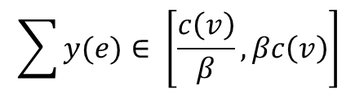

dynamic vertex cover algorithms
sets = vertices sit at various integer levels
level(element/edge e) = highest level of set containing it
4
dual(e) = $2^{− level(e)}$
…
Every vertex should be (approx.) feasible for dual
1
$$\sum{y(e)}∈ \left[\frac{c\left(v\right)}{β}, βc\left(v\right)\right]$$
0
So move vertices up/down as needed to satisfy this (approximately).
[Bhattacharya Henzinger Italiano, … ]

Slide 18
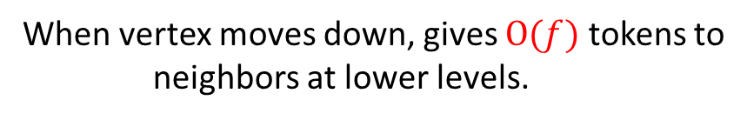
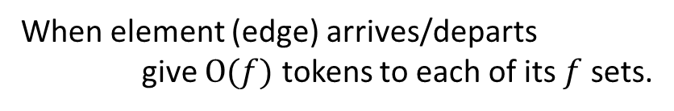
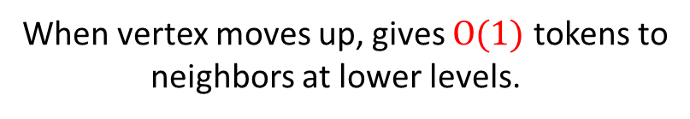
new component of our analysis
Analysis also uses tokens.
When element (edge) arrives/departs
give $O(f)$ tokens to each of its $f$ sets.
4
When vertex moves down, gives $O(f)$ tokens to
neighbors at lower levels.
…
Asymmetric
When vertex moves up, gives $O(1)$ tokens to
neighbors at lower levels.
1
0
Show that no set spends more than it receives….

Slide 19
so in summary…
dynamically maintain basic approximation algorithms
alternate view: for combinatorial optimization problems online,
allowing bounded recourse can improve the competitive ratio qualitatively.
Give $O(min⁡(log{n}, f))$ competitive algorithms with O(1) changes per timestep (amortized)
Give $O(min⁡(log{n}, f^{3}))$ competitive algorithms with $O(f\log{n)+O\left(f^{2}\right)}$ update time (amortized)
Q: Do we need amortization? From the online perspective, no.
Can maintain $O(log⁡n)$ competitive solution with O(1) changes per timestep. But need exponential time.
Q: Maintain $O\left(1\right)$ competitive fractional set cover solution with O(1) recourse?
thanks!

