Slide 1

Online Algos: Worst case and Beyond
Introduction and Set Cover
Anupam Gupta (NYU)

Slide 2

Online Algorithms
Requests arrive over time, must be served immediately/irrevocably
Goal: (say) minimize cost of the decisions taken
Competitive ratio of algorithm $A$:
$\max_{ instances I}{ \frac{cost of algorithm A on instance I}{optimal cost to serve I}}$
Want to minimize the competitive ratio.
worst case!
[Graham 66, Sleator Tarjan 85]

Slide 3
Online Set Cover
Set system. n elements arrive over time, want to maintain a cover.
Goal: minimize cost of sets picked
Competitive ratio of algorithm $A$:
$\max_{ instances I}{ \frac{cost of algorithm A on instance I}{optimal cost to serve I}}$
Want to minimize the competitive ratio.
$$S_{1}$$
$$v_{1}$$
$$v_{3}$$
$$v_{2}$$
$$S_{3}$$
$$S_{2}$$
[Alon Awerbuch Azar Buchbinder Naor 03]

Slide 4

Online Load Balancing
$m$ machines. Jobs arrive over time, can be assigned to subset of machines.
Goal: minimize maximum load of machines
Competitive ratio of algorithm $A$:
$\max_{ instances I}{ \frac{cost of algorithm A on instance I}{optimal cost to serve I}}$
Want to minimize the competitive ratio.
[Azar Naor Rom 92]

Slide 5




Online Convex Body Chasing
Each time convex body $K_{t}$ appears. Must output $x_{t}∈K_{t}$
Goal: minimize $\sum_{t}{| x_{t} −x_{t−1}|}.$
Competitive ratio of algorithm $A$:
$\max_{ instances I}{ \frac{cost of algorithm A on instance I}{optimal cost to serve I}}$
Want to minimize the competitive ratio.
$$x_{1}$$
$$x_{2}$$
$$x_{3}$$
[Freedman Linial 94]

Slide 6


max-K finding
Competitive ratio of algorithm $A$:
$\max_{ instances I}{ \frac{cost of algorithm A on instance I}{optimal cost to serve I}}$
Want to minimize the competitive ratio.
$n$ people arrive over time, each has value $v_{i}$ -- can pick at most $K$
Goal: (say) maximize sum of values of picked people
Competitive ratio of algorithm $A$:
$\min_{ instances I}{ \frac{value of algorithm A on instance I}{optimal value on instance I}}$
Want to maximize the competitive ratio.
[Gardner 60, Dynkin 63]

Slide 7
goals for this week
What are the results?
What are the techniques?
What are the worst-case limitations?
How to bypass them beyond worst-case?
Connections to other sequential decision-making models/algos?

Slide 8
lecture plan
Lecture #1: Set Cover (worst case)
Lecture #2: Set Cover (beyond worst case), Network design (both)
Lecture #3: Resource Allocation (aka packing)
Lecture #4: Search Problems (aka chasing)

Slide 9
Two Online Models

Slide 10
competitive analysis vs regret minimization
optimization in the face of uncertainty
“Reactive” settings
“Predictive” settings
See request, take action
Predict next step, then see reality
Compare to the best solution in hindsight
Obj: Competitive ratio
Obj: Regret
CR = ALG/OPT
regret = ALG - OPT
Typically OPT = best dynamic solution
Typically OPT = best static solution
several techniques in common…

Slide 11
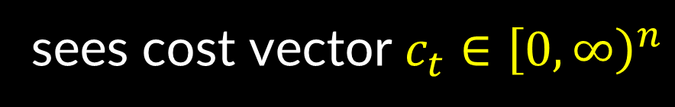
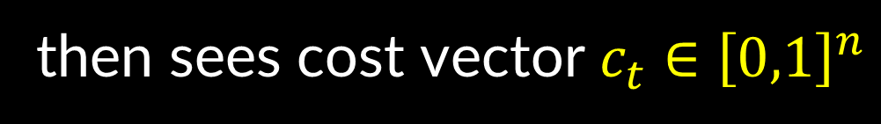



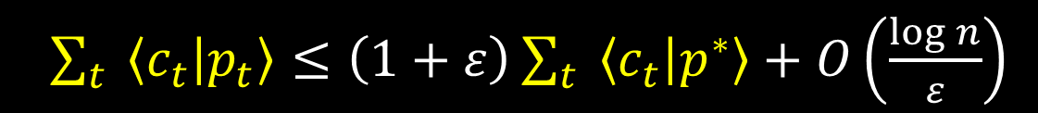

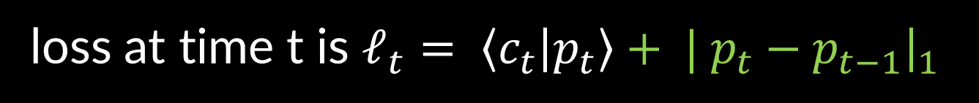
two canonical online problems
online linear optimization (OLO)
“smoothed” OLO (aka uniform MTS)
each day t = 1, 2, …, T
each day t = 1, 2, …, T
algorithm plays probability vector $p_{t}∈Δ_{n}$
sees cost vector $c_{t}∈{\left[0,∞\right)}^{n}$
then sees cost vector $c_{t}∈{\left[0,1\right]}^{n}$
then algorithm plays probability vector $p_{t}∈Δ_{n}$
loss at time t is $ℓ_{t}= \left\langle c_{t} | p_{t}\right\rangle$
loss at time t is $ℓ_{t}= \left\langle c_{t} | p_{t}\right\rangle + | p_{t}−p_{t−1}{\left.​\right|}_{1}$
Theorem: algorithm that achieves
Theorem: algorithm that achieves
$\sum_{t}{ \left\langle c_{t} | p_{t}\right\rangle }≤\left(1+ε\right)\sum_{t}{ \left\langle c_{t} | p^{∗}\right\rangle }+O\left(\frac{\log{n}}{ε}\right)$
$\sum_{t}{ \left\langle c_{t} | p_{t}\right\rangle + |p_{t}−p_{t−1}|}≤O\left(\log{n}\right) \left( \sum_{t}{ \left\langle c_{t} | p_{t}^{∗}\right\rangle }+\sum_{t}{\left|p_{t}^{∗}−p_{t−1}^{∗}\right|} \right)$
for every $p^{∗}∈Δ_{n}$
for every $p_{1}^{∗},p_{2}^{∗},{…p}_{T}^{∗}∈Δ_{n}$

Slide 12


two canonical online problems
online linear optimization (OLO)
“smoothed” OLO (aka uniform MTS)
each day t = 1, 2, …, T
each day t = 1, 2, …, T
algorithm plays probability vector $p_{t}∈Δ_{n}$
sees cost vector $c_{t}∈{\left[0,∞\right)}^{n}$
then sees cost vector $c_{t}∈{\left[0,1\right]}^{n}$
then algorithm plays probability vector $p_{t}∈Δ_{n}$
loss at time t is $ℓ_{t}= \left\langle c_{t} | p_{t}\right\rangle$
loss at time t is $ℓ_{t}= \left\langle c_{t} | p_{t}\right\rangle + | p_{t}−p_{t−1}{\left.​\right|}_{1}$
Theorem: algorithm that achieves
Theorem: algorithm that achieves
$\sum_{t}{ \left\langle c_{t} | p_{t}\right\rangle }≤\left(1+ε\right)\sum_{t}{ \left\langle c_{t} | p^{∗}\right\rangle }+O\left(\frac{\log{n}}{ε}\right)$
$\sum_{t}{ \left\langle c_{t} | p_{t}\right\rangle + |p_{t}−p_{t−1}|}≤\left(1+ε\right)\sum_{t}{ \left\langle c_{t} | p_{t}^{∗}\right\rangle }+O\left(\frac{\log{n}}{ε}\right)\sum_{t}{|p_{t}^{∗}−p_{t−1}^{∗}|}$
for every $p^{∗}∈Δ_{n}$
for every $p_{1}^{∗},p_{2}^{∗},{…p}_{T}^{∗}∈Δ_{n}$
[Blum Burch Kalai 99]

Slide 13
online algorithms vs online learning
optimization in the face of uncertainty
“Reactive” settings
“Predictive” settings
See request, take action
Predict next step, then see reality
Compare to the best solution in hindsight
Obj: Competitive ratio
Obj: Regret
CR = ALG/OPT
regret = ALG - OPT
Typically OPT = best dynamic solution
Typically OPT = best static solution
several techniques in common…

Slide 14
Set Cover

Slide 15


(minimum) set cover
$|𝒰|=n=$# elements
$|ℱ|=m=$# sets
$$f=\max_{e}{\text{\#(}\text{sets} \text{containing} \text{e}\text{)}}$$
Goal: pick smallest # sets to cover all elements.
“weighted” problem: sets have costs, minimize cost of cover

Slide 16










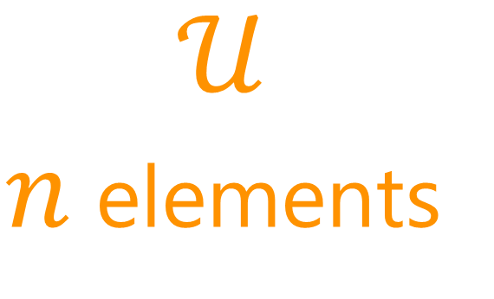



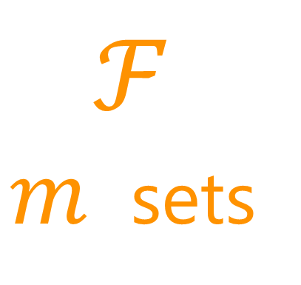
set cover as bipartite graph
$$≤f$$
$$s_{1}$$
$$v_{1}$$
$$v_{1}$$
$$s_{2}$$
$$v_{2}$$
$$v_{2}$$
$$ℱ$$
$m$ sets
$$𝒰$$
$n$ elements
$$s_{3}$$
$$v_{3}$$
$$v_{3}$$
$$s_{4}$$
$$v_{4}$$
$$v_{4}$$
$$s_{5}$$
$$v_{5}$$
$$v_{5}$$
$$s_{6}$$
$$v_{6}$$
$$v_{6}$$

Slide 17
Online Set Cover
$$s_{1}$$
$$v_{1}$$
$$s_{2}$$
$$v_{2}$$
$$ℱ$$
$m$ sets
$$𝒰$$
$n$ elements
$$s_{3}$$
$$v_{3}$$
$$s_{4}$$
$$v_{4}$$
$$s_{5}$$
$$v_{5}$$
$$s_{6}$$
$$v_{6}$$

Slide 18

online set cover: model choices
Including order of elements
Adversary fixes $(𝒰, ℱ)$ and set costs (if applicable)
Algo sees elements of $𝒰$ one by one
When element $e$ seen, then find out which sets contain $e$
If $e$ not covered by current set cover, pick set(s) to cover $e$
Instance is not “adaptive” to decisions of algorithm (relevant if randomized algo)
Called “oblivious adversary”.

Slide 19





Deterministic Fail
$$s_{1}$$
$$v_{1}$$
$$s_{2}$$
$$v_{2}$$
$$ℱ$$
$m$ sets
$$𝒰$$
$n$ elements
$$s_{3}$$
$$v_{3}$$
$$s_{4}$$
$$s_{5}$$
$$s_{6}$$
$ALG=n$, $OPT=1$
$Ω(n)$ competitive

Slide 20
Randomization: A New Hope
$$s_{1}$$
$$v_{1}$$
$$s_{2}$$
$$v_{2}$$
$$ℱ$$
$m$ sets
$$𝒰$$
$n$ elements
$$s_{3}$$
$$v_{3}$$
$$s_{4}$$
$$s_{5}$$
$$s_{6}$$
What’s a good strategy for randomizing?

Slide 21




Uniform Sampling (for unit costs)
$f=$ max-degree
of any element
$$s_{1}$$
$$v_{1}$$
$$s_{2}$$
$$v_{2}$$
$$s_{3}$$
$$v_{3}$$
$$s_{4}$$
$$s_{5}$$
If $e$ not covered
Pick uniformly random set covering $e$
$$s_{6}$$
Theorem [Pitt 75]: $f$-competitive

Slide 22


Proof
$f=$ max-degree
of any element
$$OPT$$
$$s_{1}$$
$$s_{2}$$
$$s_{3}$$
$$s_{4}$$
$$s_{5}$$
$$𝔼\left[Geom\left(1/f\right)\right]=f$$
$$s_{6}$$
Theorem [Pitt 75]: $f$-competitive

Slide 23
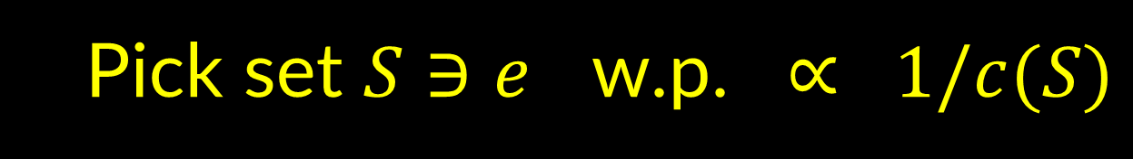
Extension for general costs
$f=$ max-degree
of any element
$$s_{1}$$
$$v_{1}$$
$$s_{2}$$
$$v_{2}$$
$$s_{3}$$
$$v_{3}$$
$$s_{4}$$
$$s_{5}$$
If $e$ not covered
Pick set $S∋e$ w.p. $∝ 1/c(S)$
$$s_{6}$$
Theorem [Pitt 75]: $f$-competitive

Slide 24

roadmap for today
Intro to Online Algorithms
Set cover
Theorem: $f$-competitive using Pitt’s algo
Online algo (using relax-and-round)
Some (almost) matching hardness results
[Prob Wednesday] How to go beyond worst-case?
When requests from known distribution
When requests from unknown distribution

Slide 25
roadmap for today
Intro to Online Algorithms
Set cover
Theorem: $f$-competitive using Pitt’s algo
Online algo (using relax-and-round)
Some (almost) matching hardness results
[Prob Wednesday] How to go beyond worst-case?
When requests from known distribution
When requests from unknown distribution

Slide 26





relax-and-round (offline)
Integer linear program for set cover:
min $\sum_{S}{c\left(S\right) x_{S}}$
$\sum_{S:e∈S}{x_{S}} ≥ 1$ for all elements $e$
$x_{S}∈\{0,1\}$
“relax the problem”
$$LP≤OPT$$
$x_{S}≥0$
[folklore? Johnson?]

Slide 27

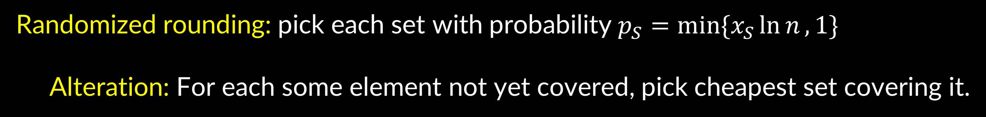
relax-and-round (offline)
Integer linear program for set cover:
min $\sum_{S}{c\left(S\right) x_{S}}$
$\sum_{S:e∈S}{x_{S}} ≥ 1$ for all elements $e$
$x_{S}∈\{0,1\}$
“relax the problem”
$$LP≤OPT$$
$x_{S}≥0$
Randomized rounding: pick each set with probability $p_{S}=min\{x_{S}\ln{n}, 1\}$
Alteration: For each some element not yet covered, pick cheapest set covering it.
Pr[e not covered by RR] = $Π_{S :e∈S}\left(1−p_{S}\right)≤e^{− \sum_{S:e∈S}{p_{S}}}$
$≤e^{−\ln{n}\sum_{S:e∈S}{x_{S}}}≤1/n$.
Expected cost $≤LP⋅\ln{n}+\sum_{e}{1/n}⋅cheapest set covering e≤LP(1+ ln{n})$.
[folklore? Johnson?]

Slide 28

relax-and-round (online)
Integer linear program for set cover:
min $\sum_{S}{c\left(S\right) x_{S}}$
$\sum_{S:e∈S}{x_{S}} ≥ 1$ for all elements $e$
$x_{S}∈\{0,1\}$
“relax the problem”
$$LP≤OPT$$
$x_{S}≥0$
Solving: How to solve LP as elements arrive? We’ll see soon.
N.b. want $x_{S}$ values to only increase (captures online nature)
Online rounding: at each timestep, buy each set $S$w.p. $\min{( Δx_{S}\ln{n}, 1 )}$
Same analysis: total cost $O\left(\ln{n}\right) LP$.
[Alon Awerbuch Azar Buchbinder Naor 03]

Slide 29

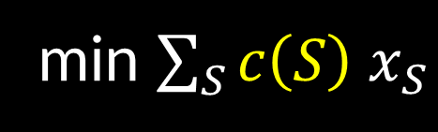


solving set cover LP online
min $\sum_{S}{{c\left(S\right) x}_{S}}$
$\sum_{S:e∈S}{x_{S}} ≥ 1$ for all $e$
When element $e$ arrives:
Until $e$ fractionally covered
increase its fractional coverage “multiplicatively”
$x_{S}≥0$
Theorem 1: get fractional set cover of cost $O\left(log m\right) OPT$.
$⇒$Theorem 2: Above+rand.round produces integer set cover with E[cost] $O\left(log m\log{n}\right) OPT$.

Slide 30


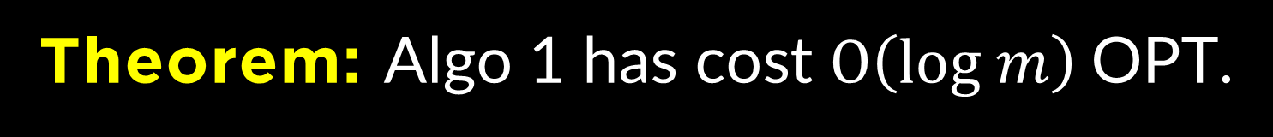

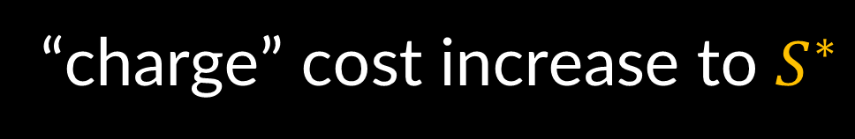
solving set cover LP online
min $\sum_{S}{x_{S}}$
$\sum_{S:e∈S}{x_{S}} ≥ 1$ for all $e$
$x_{S}≥0$
Algo 1: (unit cost sets)
$x_{S}←1/m$ for all $S$
When element e arrives with $\sum_{S:e∈S}{x_{S}}<1$:
Repeatedly do $x_{S}←2x_{S}$ forall $S∋e$ until $\sum_{S:e∈S}{x_{S}}≥1$.
1/4
1/8
1/2
1/4
1/8
1/2
Theorem: Algo 1 has cost $O\left(log m\right)$OPT.
Proof:
If element $e$ fractionally uncovered:
increase objective by $≤$ 2. Also, increase $x_{S^{∗}}$ where $S^{∗}$ is $OPT$ set covering $e$
“charge” cost increase to $S^{∗}$
$x_{S^{∗}}$ doubled at most $log m$ times
1/16
1/32
1/8

Slide 31
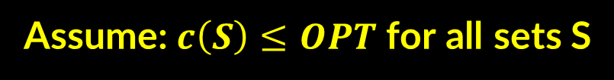


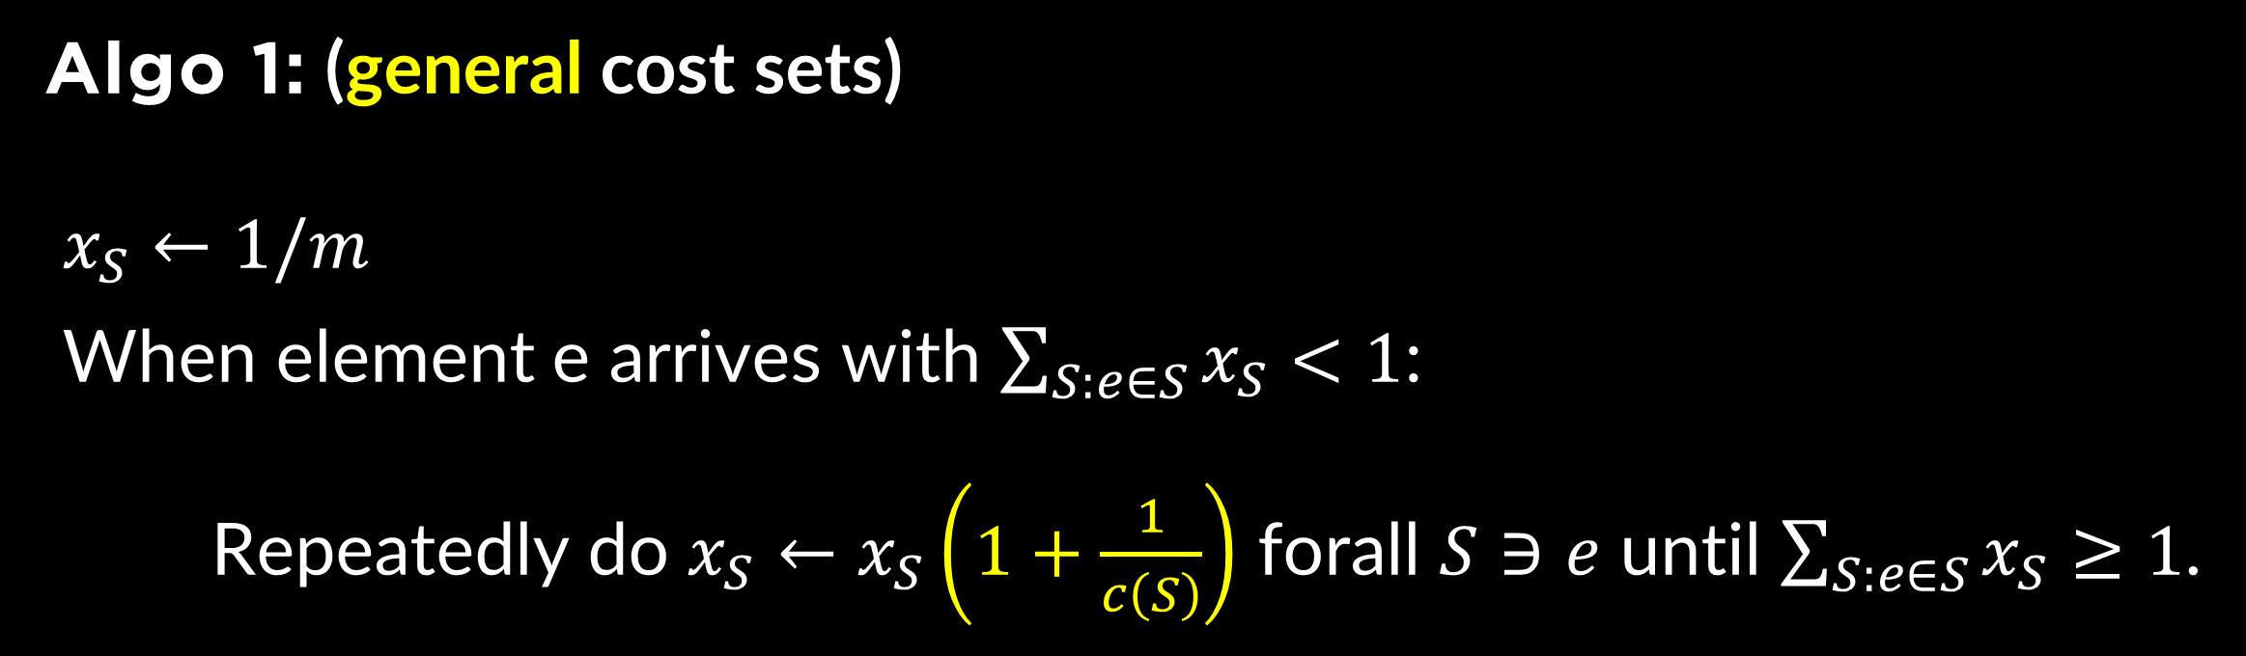


solving set cover LP online (costs)
min $\sum_{S}{{c\left(S\right) x}_{S}}$
$\sum_{S:e∈S}{x_{S}} ≥ 1$ for all $e$
$x_{S}≥0$
Algo 1: (general cost sets)
$x_{S}←1/m$
When element e arrives with $\sum_{S:e∈S}{x_{S}}<1$:
Repeatedly do $x_{S}←x_{S}\left(1+\frac{1}{c\left(S\right)}\right)$ forall $S∋e$ until $\sum_{S:e∈S}{x_{S}}≥1$.
Assume: $c\left(S\right)≤OPT$ for all sets S
new cost
old cost
old coverage
$$\sum_{S}{c\left(S\right) x_{S}\left(1+\frac{1}{c\left(S\right)}\right)}=\sum_{S}{c\left(S\right)x_{S}}+\sum_{S}{x_{S}}$$
Theorem: Algo 1 has cost $O\left(log m\right)$OPT.
Proof:
If element $e$ fractionally uncovered:
increase objective by $≤$ 2. Increase $x_{S^{∗}}$ where $S^{∗}$ is $OPT$ set covering $e$
“charge” cost increase to $S^{∗}$
$x_{S^{∗}}$ increased at most $c(S) log m$ times

Slide 32




remove assumption: “guess and double”
Maintain a “guess” $G$ for value of OPT, say $OPT∈(G,2G]$
Discard all sets with cost more than $2G$
Run $α$-competitive algorithm
If total cost incurred $>α (2G)$, have proof that $OPT>2G$
set $G←2G$
total cost = geometric sum, so at most $4α G$

Slide 33

summary
min $\sum_{S}{{c\left(S\right) x}_{S}}$
$\sum_{S:e∈S}{x_{S}} ≥ 1$ for all $e$
When element $e$ arrives:
Until $e$ fractionally covered:
increase its fractional coverage “multiplicatively”
$x_{S}≥0$
Theorem: get fractional set cover of cost $O\left(log m\right) OPT$.
Theorem: (being bit careful) fractional set cover of cost $O\left(log f\right) OPT$.
$⇒$Theorem: Above+rand.round produces integer set cover with E[cost] $O\left(log f\log{n}\right) OPT$.

Slide 34
roadmap for today
Intro to Online Algorithms
Set cover
Theorem: $f$-competitive using Pitt’s algo
Online algo (using relax-and-round)
Theorem: $O(log m log n)$-competitive using relax-and-round
Some (almost) matching hardness results
[Prob Wednesday] How to go beyond worst-case?
When requests from known distribution
When requests from unknown distribution

Slide 35




lower bounds (1)
$n$ elements
one set for every $\sqrt{n}$ elements: $m= \left({n \atop \sqrt{n}}\right)=\exp\left(\sqrt{n}\log{n}\right)$
Input: $\sqrt{n}$ random elements
$$OPT=1$$
Until we pick $≤\sqrt{n}/2$ sets, then Pr[ next random element is uncovered ] $≥1/2.$
$⇒𝔼\left[cost\right]≥\sqrt{n}/2$ $= \frac{\log{m}}{\log{\log{m}}}$
Lower bound holds against randomized algorithms.

Slide 36


Yao’s lemma
“exists distribution on inputs s.t.
best deterministic algo. has comp.ratio. $≥blah$”
$⇒$“best rand. algo. has comp.ratio. $≥blah$”

Slide 37

Yao’s lemma
Det. Algos. (column player, minimizing)
Instances (row player, maximizing)
$M_{ij}$ = payoff to row player playing $I_{i}$
from column player playing $A_{j}$

Slide 38

Yao’s lemma
Det. Algos. (column player, minimizing)
Instances (row player, maximizing)
$M_{ij}$ = “payoff” of algorithm $A_{j}$
on input $I_{i}$

Slide 39

Yao’s lemma
Det. Algos. (column player, minimizing)
Instances (row player, maximizing)
${\left(Mq\right)}_{i}$ = “payoff” of randomized algorithm $q$
on input $I_{i}$
$M_{ij}$ = “payoff” of algorithm $A_{j}$
on input $I_{i}$

Slide 40

Yao’s lemma
Det. Algos. (column player, minimizing)
Instances (row player, maximizing)
$\max_{i}{{\left(Mq\right)}_{i}}$ = “payoff” of randomized algorithm $q$
on worst-case input $I_{i}$
$M_{ij}$ = “payoff” of algorithm $A_{j}$
on input $I_{i}$

Slide 41
Yao’s lemma
Det. Algos. (column player, minimizing)
Instances (row player, maximizing)
$\max_{i}{{\left(Mq\right)}_{i}}$ = “payoff” of randomized algorithm $q$
on worst-case input $I_{i}$
$M_{ij}$ = “payoff” of algorithm $A_{j}$
on input $I_{i}$

Slide 42

Yao’s lemma
Det. Algos. (column player, minimizing)
Instances (row player, maximizing)
$\max_{i}{e_{i}^{T}Mq}$ = “payoff” of randomized algorithm $q$
on worst-case input $I_{i}$
$M_{ij}$ = “payoff” of algorithm $A_{j}$
on input $I_{i}$

Slide 43
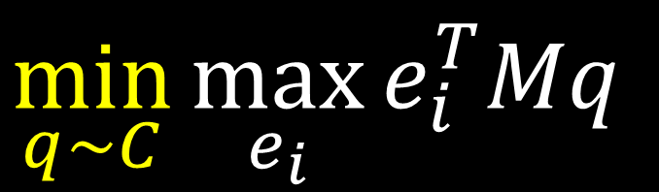
Yao’s Lemma
$$\min_{q\sim C}{\max_{e_{i}}{e_{i}^{T}Mq}}$$

Slide 44

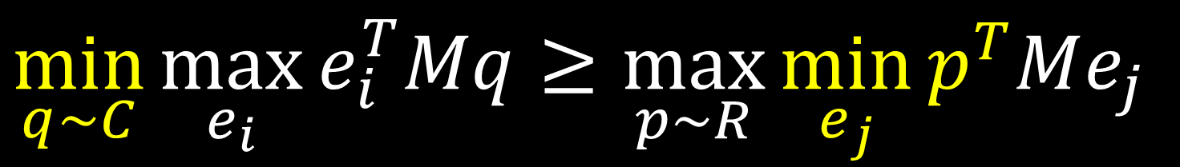


Yao’s Lemma
$$\min_{q\sim C}{\max_{e_{i}}{e_{i}^{T}Mq}}≥\max_{p\sim R}{\min_{e_{j}}{p^{T}Me_{j}}}$$
“for every rand. algo. there exists input $I_{i}$
which causes comp.ratio. $≥blah$”
“exists distrib $p$on inputs s.t.
best det. algo. $A_{j}$ has comp.ratio. $≥blah$”
“best rand. algo. has comp.ratio. $≥blah$”
weak LP duality

Slide 45
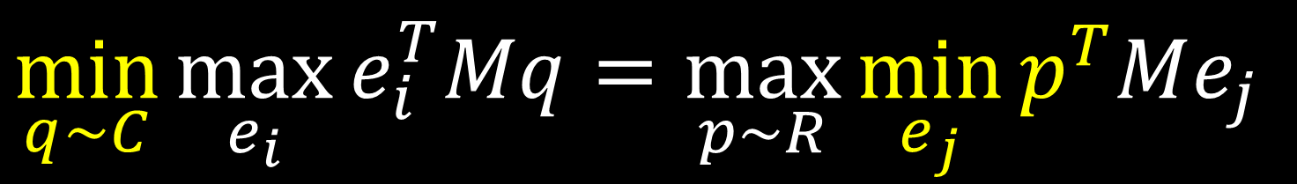
von Neumann minimax theorem
$$\min_{q\sim C}{\max_{e_{i}}{e_{i}^{T}Mq}}=\max_{p\sim R}{\min_{e_{j}}{p^{T}Me_{j}}}$$
strong LP duality

Slide 46

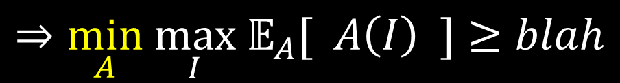






in more detail…
for some $𝒟$, have $\min_{A}{𝔼_{I∼𝒟}[ A\left(I\right) ]}≥blah$
“exists distrib on inputs s.t.
best det. algo. has comp.ratio. $≥blah$”
$$⇒\max_{𝒟}\min_{A}{𝔼_{I∼𝒟}[ A\left(I\right) ]}≥blah$$
$$⇒\min_{A} \max_{I} 𝔼_{A}[ A\left(I\right) ]≥blah$$
“best rand. algo. has comp.ratio. $≥blah$”
$$\max_{𝒟}\min_{A}{𝔼_{I∼𝒟}\left[\frac{A\left(I\right)}{OPT(I)}\right] }≥blah$$
$$⇒\min_{A} \max_{I}\frac{𝔼[A\left(I\right)]}{OPT(I)}≥blah$$
$$\max_{𝒟}\min_{A}{\frac{𝔼_{I∼𝒟}[ A\left(I\right) ]}{𝔼_{I∼𝒟}[OPT\left(I\right)]} }≥blah$$

Slide 47
another set cover lower bound
Adversary: pick random leaf, give elements top-down. Sets = leaves, cover ancestors
For any deterministic algorithm $A$, expected cost = $(k+1)/2$ $=Ω(log m+log n)$
Now use Yao’s lemma: exists $𝒟$ on instances s.t. any deterministic algo has competitive ratio $≥blah$
$⇒$ for any randomized algo, exists instance s.t. has competitive ratio $≥blah$

Slide 48
lower bounds (3)
Theorem [Feige/Korman]: every poly-time (randomized) online algo has competititve ratio $Ω\left(\log{m}\log{n}\right).$
Theorem [Feige, Dinur/Steurer]: every poly-time offline (randomized) algo has approx. ratio $Ω\left(\log{n}\right).$

Slide 49
Different Perspective on Fractional Algo

Slide 50
unweighted set cover
$$K_{t}=\left\{x≥0 \right| \left\langle a^{s}, x\right\rangle ≥1 ∀s≤t, x≥x^{t−1}\}$$

Slide 51






unweighted set cover
Request at time t:
$\left\langle a^{t}, x\right\rangle ≥1$ for some $a^{t}∈{\left\{0,1\right\}}^{n}$.
Let $K_{t}=\left\{x≥0 \right| \left\langle a^{s}, x\right\rangle ≥1 ∀s≤t, x≥x^{t−1}\}$
Output at time t: point $x^{t}∈K_{t}$
Cost at time t: ${\left|| x^{t} −x^{t−1}|\right|}_{1}=\sum_{i}{| x_{i}^{t}−x_{i}^{t−1} |}$
Total cost until time t: $|{\left|x^{t}|\right|}_{1}= \left\langle {1, x}^{t}\right\rangle$
$$\min_{x≥0}⁡ \left\langle {1, x}^{t}\right\rangle$$
$$x_{1}+x_{2}+x_{3}+ … +x_{n}≥1$$
$$x_{2}+x_{3}+ … +x_{n}≥1$$
$$x_{3}+ … +x_{n}≥1$$
$$x_{n}≥1$$

Slide 52
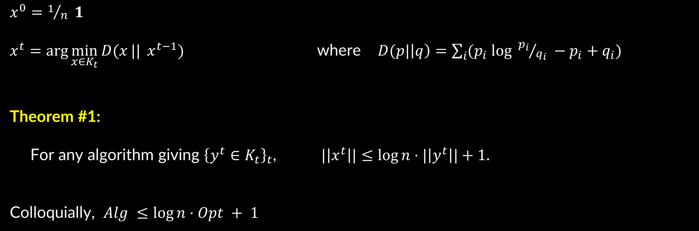
an algorithm
$x^{0}=1/n 1$
$x^{t}=\arg{\min_{x∈K_{t}}{D(x}||} x^{t−1})$ where $D(p|\left|q\right)=\sum_{i}{{(p}_{i}\log{ {p_{i}}/{q_{i}}} −p_{i}+q_{i})}$
Theorem #1:
For any algorithm giving ${\left\{y^{t}∈K_{t}\right\}}_{t}$, $|\left|x^{t}\right||≤\log{n}⋅|\left|y^{t}\right||+1$.
Colloquially, $Alg ≤\log{n}⋅Opt + 1$

Slide 53

an algorithm
$x^{0}=1/n 1$
$x^{t}=\arg{\min_{x∈K_{t}}{D(x}||} x^{t−1})$ where $D(p|\left|q\right)=\sum_{i}{{(p}_{i}\log{ {p_{i}}/{q_{i}}} −p_{i}+q_{i})}$
Fact: $x^{t}=\arg{\min_{x:\left\langle a^{t}, x\right\rangle ≥1}{D(x||x^{t−1}})}$
Pf: the Lagrangian is $\sum_{i}{ (x_{i}^{t}\log{{x_{i}^{t}}/{x_{i}^{t−1}}} −x_{i}^{t}+x_{i}^{t−1})}+λ_{t}(1 −\sum_{i}{a_{ti}x_{i}^{t}}$) for $λ_{t}≥0.$
So KKT says: $\log{{x_{i}^{t}}/{x_{i}^{t−1}}}−{λ_{t}a}_{ti}=0$.
$⇒ x_{i}^{t}=x_{i}^{t−1} e^{λ_{t}a_{ti}}.$
Mult.weights!!! Since $a_{ti}≥0$, $x$ monotone increasing and sat’s older constraints too.

Slide 54


unweighted set cover
$$D(p|\left|q\right)=\sum_{i}{{(p}_{i}\log{ {p_{i}}/{q_{i}}} −p_{i}+q_{i})}$$
Movements are projections according to $D$
Can be used to give
potential-function proof

Slide 55
The Price of Uncertainty

Slide 56


price of uncertainty
Offline
Online
Set Cover
$Θ(\log{n})$
$$Θ(\log{m\log{n}})$$
can we do better in non-worst-case settings?

Slide 57

that’s it for today…
Intro to Online Algorithms
Set cover
Theorem: $f$-competitive using Pitt’s algo
Online algo (using relax-and-round)
Theorem: $O(log m log n)$-competitive using relax-and-round
Some (almost) matching hardness results
[Wednesday] How to go beyond worst-case?
When requests from known distribution
Theorem: $O(log m+log n)$-competitive using universal maps
When requests from unknown distribution
Theorem: $O(log m+log n)$-competitive using learn-or-cover

Slide 58
lecture plan
Lecture #1: Set Cover (worst case)
Lecture #2: Set Cover (beyond worst case), Network design (both)
Lecture #3: Resource Allocation (aka packing)
Lecture #4: Search Problems (aka chasing)

