Slide 1

Online Algos: Old and New
Set Cover: Beyond the Worst case
Anupam Gupta (NYU)

Slide 2
analysis of algorithms
Ideally: want to get algorithms that are good for
worst-case and best-case and …. all cases.
Worst-case: robustness when data is unpredictable
Best-case: efficiency when data follows anticipated patterns
How to model these?
let’s see glimpse of ideas/techniques in context of online algos

Slide 3


price of uncertainty
Offline
Online
Set Cover
$Θ(\log{n})$
$$Θ(\log{m\log{n}})$$
can we do better in non-worst-case settings?

Slide 4
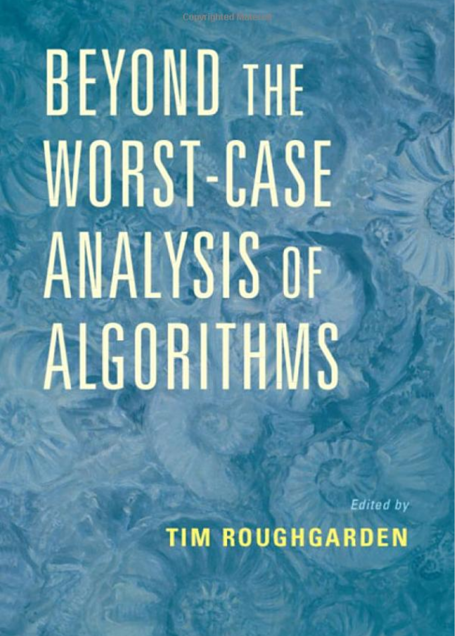
going beyond the worst case
Ways to model non-worst-case instances
special structure to the instances
requests are “predictable”
arrival order is not worst-case?
train NN to find patterns, give predictions
…

Slide 5
Known Input Distributions

Slide 6

roadmap for today
Intro to Online Algorithms
Set cover
Theorem: $f$-competitive using Pitt’s algo
Online algo (using relax-and-round)
Theorem: $O(log m log n)$-competitive using relax-and-round
Some (almost) matching hardness results
How to go beyond worst-case?
When requests from known distribution
When requests from unknown distribution

Slide 7


Stochastic Model
Given: set system (U, $ℱ$), possibly with set cost c(S).
Request sequence $σ$ = {x₁, x₂, …, x_{k}} arrives online.
Each x_{t} is drawn uniformly at random from U.
On seeing request x_{t} that is yet uncovered, output some set S_{t} covering it.
Want to minimize the E[ cost of sets output on $σ$ ]
again, compared to E[ cost of optimal solution for $σ$ ]
In general, element $e∈U$ drawn w.p. $p_{e}$
[Grandoni G. Leonardi Miettinen Sankowski Singh]

Slide 8

Special solutions: Universal Maps
Given: set system (U, $ℱ$), possibly with set cost c(S).
Request sequence $σ$ = {x₁, x₂, …, x_{k}} arrives online.
Each x_{t} is drawn uniformly at random from U.
Up-front, give a “universal mapping”
associate set S(e) in $ℱ$ with each element e in U.
Want to minimize the E[ cost of sets output on $σ$ ]
again, compared to E[ cost of optimal solution for $σ$ ]

Slide 9
Universal Solutions
A potential solution:

Slide 10
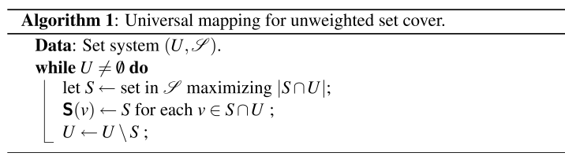
Universal Solutions
Theorem: Map given by greedy algorithm is O(log m + log n) competitive.
Each element is mapped to first set in greedy that covers it.

Slide 11
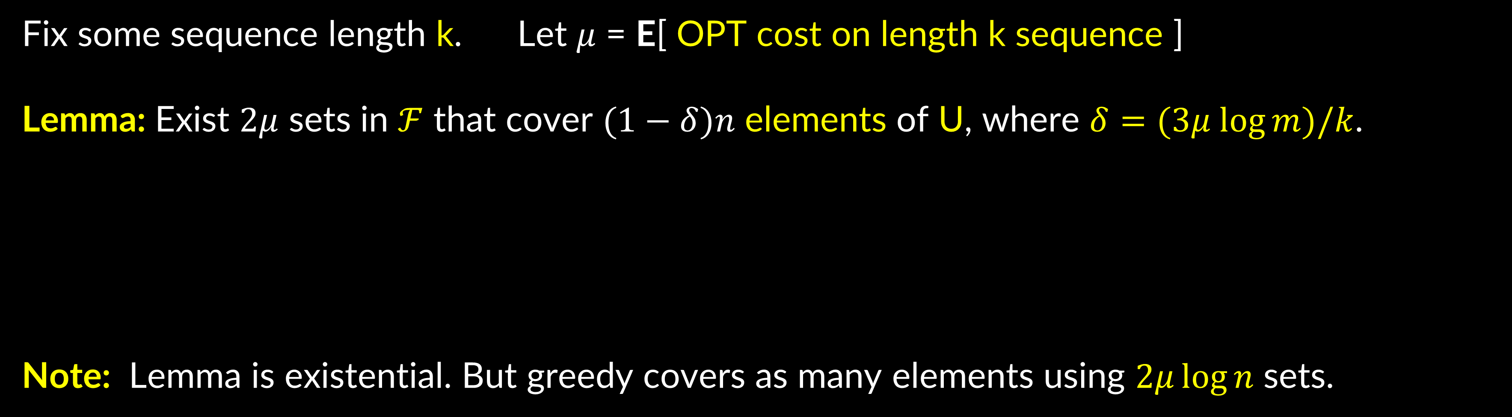
Exists Good Universal Map
Fix some sequence length k. Let $μ$ = E[ OPT cost on length k sequence ]
Lemma: Exist $2μ$ sets in $ℱ$ that cover $(1−δ)n$ elements of U, where $δ=(3μ log⁡m)/k$.
Note: Lemma is existential. But greedy covers as many elements using $2μ\log{n}$ sets.
Proof: next slide

Slide 12

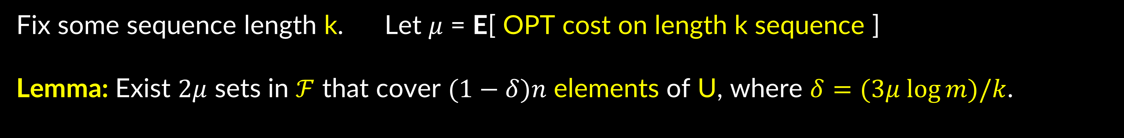

Exists Good Universal Map
Fix some sequence length k. Let $μ$ = E[ OPT cost on length k sequence ]
Lemma: Exist $2μ$ sets in $ℱ$ that cover $(1−δ)n$ elements of U, where $δ=(3μ log⁡m)/k$.
Proof: Consider all the $n^{k}$ sequences
Expected number of sets in OPT is $μ$
$⇒$ at least $½n^{k}$ “good” sequences can be covered by $2μ$ sets
Consider “bags” of elements $C_{1}, C_{2}, …, C_{L}$ got by taking unions of $2μ$ sets.
For contradiction, suppose each bag has $≤\left(1−δ\right)n$ elements.
$$L=m^{2μ}$$
Another way to generate good sequences: pick $C_{i}$ and pick $k$ elements
So: $L×{\left[\left(1−δ\right)n\right]}^{k}≥$ $½n^{k}$ $⇒m^{2μ} e^{−δk}≥1/2.$

Slide 13
Wrap-up
Fix some sequence length k. Let $μ$ = E[ OPT cost on length k sequence ]
Lemma: Exist $2μ$ sets in $ℱ$ that cover $(1−δ)n$ elements of U, where $δ=(3μ log⁡m)/k$.
Recap: greedy covers $\left(1−δ\right)n$ “happy” elements using $2μ\log{n}$ sets.
Happy elements in our sequence covers by these many sets
E[sad elements in our sequence] = $δk=O(μ\log{m)}$, one set for each

Slide 14
roadmap for today
Intro to Online Algorithms
Set cover
Theorem: $f$-competitive using Pitt’s algo
Online algo (using relax-and-round)
Theorem: $O(log m log n)$-competitive using relax-and-round
Some (almost) matching hardness results
How to go beyond worst-case?
When requests from known distribution
Theorem: $O(log m+log n)$-competitive using universal maps
When requests from unknown distribution

Slide 15
roadmap for today
Intro to Online Algorithms
Set cover
Theorem: $f$-competitive using Pitt’s algo
Online algo (using relax-and-round)
Theorem: $O(log m log n)$-competitive using relax-and-round
Some (almost) matching hardness results
How to go beyond worst-case?
When requests from known distribution
Theorem: $O(log m+log n)$-competitive using universal maps
When requests from unknown distribution

Slide 16
Random Order

Slide 17
Random Order (RO) model
$$s_{1}$$
$$v_{1}$$
$$v_{1}$$
$$s_{2}$$
$$v_{2}$$
$$v_{2}$$
$$ℱ$$
$m$ sets
$$𝒰$$
$n$ elements
$$s_{3}$$
$$v_{3}$$
$$v_{3}$$
$$s_{4}$$
$$v_{4}$$
$$v_{4}$$
$$s_{5}$$
$$v_{5}$$
$$v_{5}$$
$$s_{6}$$
$$v_{6}$$
$$v_{6}$$

Slide 18
















LearnOrCover
[G. Kehne Levin FOCS 21]
“hands” of possible solutions
(Unit cost, exp time)
$$𝒫$$
when random element $v$ arrives
if $v$ not already covered, in parallel:
$\left(\begin{matrix}m \\ k\end{matrix}\right)$
$1$. select random remaining hand
pick random set from it
2. remove sols that don’t cover $v$
pick any set covering $v$
$$𝒰$$
Main Q: how many elements uncovered on arrival?
$$Sol R:$$

Slide 19








LearnOrCover
[G. Kehne Levin FOCS 21]
“hands” of possible solutions
(Unit cost, exp time)
$$𝒫$$
when random element $v$ arrives
if $v$ not already covered, in parallel:
$1$. select random remaining hand
pick random set from it
2. remove sols that don’t cover $v$
pick any set covering $v$
$$𝒰$$
Q: do ½ of remaining hands cover ½ of uncovered elements?
Yes: random set covers many uncovered elements!
$$Sol R:$$
No: random element removes many hands!!

Slide 20




Case 1: $≥1/2$ of $P∈𝒫$ cover $≥1/2$ of $𝒰$.
$R$ covers $\frac{|𝒰|}{4k}$ in expectation.
$𝒰$ shrinks by $\left(1−\frac{1}{4k}\right)$ in expectation.
|$𝒰$| initially $n$
$⇒$ $O(k logn)$ COVER steps suffice.
Case 2: $>1/2$ of $P∈𝒫$ cover $<1/2$ of $𝒰$.
|$𝒫$| initially $\left({m \atop k}\right)≈m^{k}$
$⇒$ $O(k logm)$ LEARN steps suffice.
$≥1/2$ of $P∈𝒫$ pruned w.p. $1/2$.
$𝒫$ shrinks by $3/4$ in expectation.
$⇒$ $O(k log mn)$ steps suffice.

Slide 21

LearnOrCover
(Unit cost, exp time)
Case 1: (COVER)
Case 2: (LEARN)
$𝒰$ shrinks by $\left(1−\frac{1}{4k}\right)$ in expectation.
$𝒫$ shrinks by $3/4$ in expectation.
Φ=1𝑘log|𝒫|+
$$\frac{1}{k}log|𝒫|$$
$$log|𝒰|$$
How to make polytime?
Can we reuse LEARN/COVER intuition?
Claim 1: $Φ(0)=O(log mn)$ and $Φ(t)≥0$.
Claim 2: If $v$ uncovered, then $E[ΔΦ]≤−Ω\left(\frac{1}{k}\right).$

Slide 22
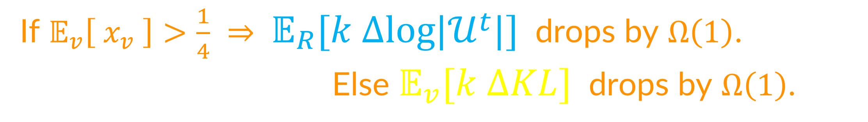
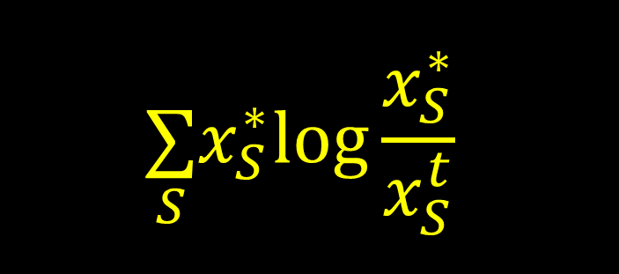
LearnOrCover
$$\underset{S}{∑}x_{S}^{∗}log\frac{x_{S}^{∗}}{x_{S}^{t}}$$
(Unit cost)
Idea: Measure convergence with potential function
Init. $x←1/m$.
$Φ(t)=c_{1}$ $\text{KL}(x^{∗}||x^{t})$ $+c_{2}$ $log|𝒰^{t}|$
@ time $t$, element $v$ arrives:
    If $v$ covered, do nothing.
$𝒰^{t}$ := uncovered elements @ time $t$
    Else:
        (I) Buy random $R∼x$.
        (II) $∀S∋v$, set $x_{S}←e⋅x_{S}$.
          Renormalize $x←x/∥x∥_{1}$.
$x^{∗}$ := uniform distribution on OPT
Claim 1: $Φ(0)=O(log mn)$, and $Φ(t)≥0$.
Buy arbitrary set to cover $v$.
Claim 2: If $v$ uncovered, then $E[ΔΦ]≤−\frac{1}{k}$.
If $𝔼_{v}\left[ x_{v} \right]>\frac{1}{4}$ $⇒ 𝔼_{R}[k Δlog|𝒰^{t}|]$ drops by $Ω\left(1\right)$.
Else $𝔼_{v}[k ΔKL]$ drops by $Ω\left(1\right)$.
(Recall $k=|OPT|$)

Slide 23

picture for set cover
Intro to Online Algorithms
Set cover
Theorem: $f$-competitive using Pitt’s algo
Online algo (using relax-and-round)
Theorem: $O(log m log n)$-competitive using relax-and-round
Some (almost) matching hardness results
How to go beyond worst-case?
When requests from known distribution
Theorem: $O(log m+log n)$-competitive using universal maps
When requests from unknown distribution
Theorem: $O(log m+log n)$-competitive using learn-or-cover

